Slide 1


CA22123 EU-MACE: European Materials Acceleration Center for Energy MC1 meeting
Sawako Nakamae (Action Chair Candidate)
Commissariat à l’Energie Atomique et aux Energies Alternatives

Slide 2
What will happen on Oct. 3rd
MC1s will have the following sections
detailed agenda not ready yet, will be distributed later
Getting to know each other (COST)
COST presentation (COST)
Action Chair Candidate presentation (Action Chair Candidate) – 20 minutes
COST Action Café (COST) – all MCs participate -20 minutes each x (4-5)
LUNCH
MC Discussion & Decisions (New elected Chair) – 30 minutes + as many hours as necessary

Slide 3
Outline
EU-MACE Action Chair presentation
• Action Challenge
• Research Coordination objectives
• Capacity Building objectives
• Deliverables
• General Action Structure
• Summary

Slide 4
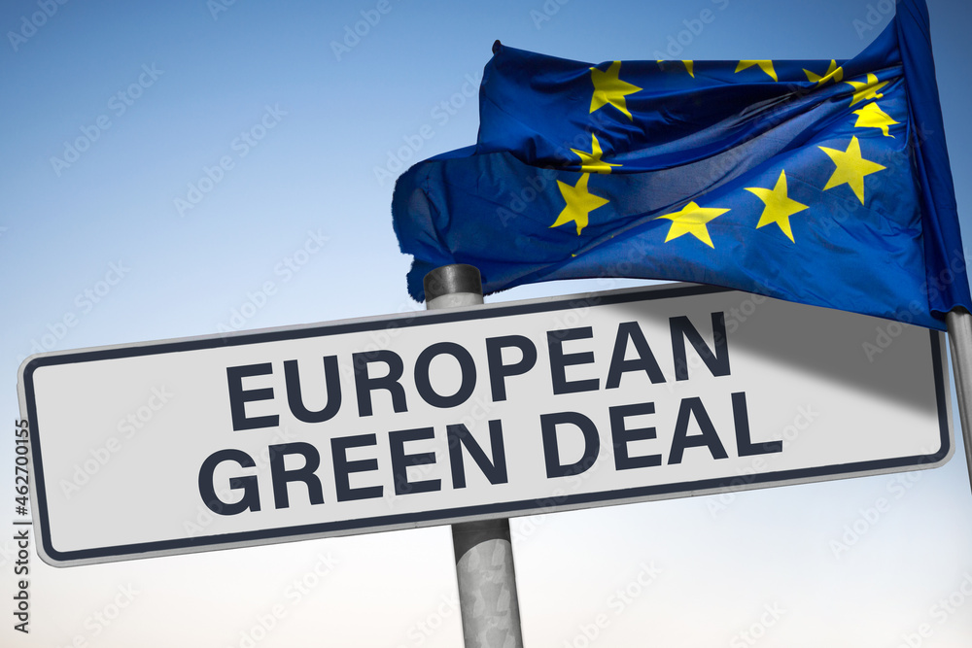
Action challenge
“Systemic approach to accelerate the identification of disruptive technologies, their device level integration and de-risking along the whole production chain of low-carbon technologies based on advanced functional materials”

Slide 5
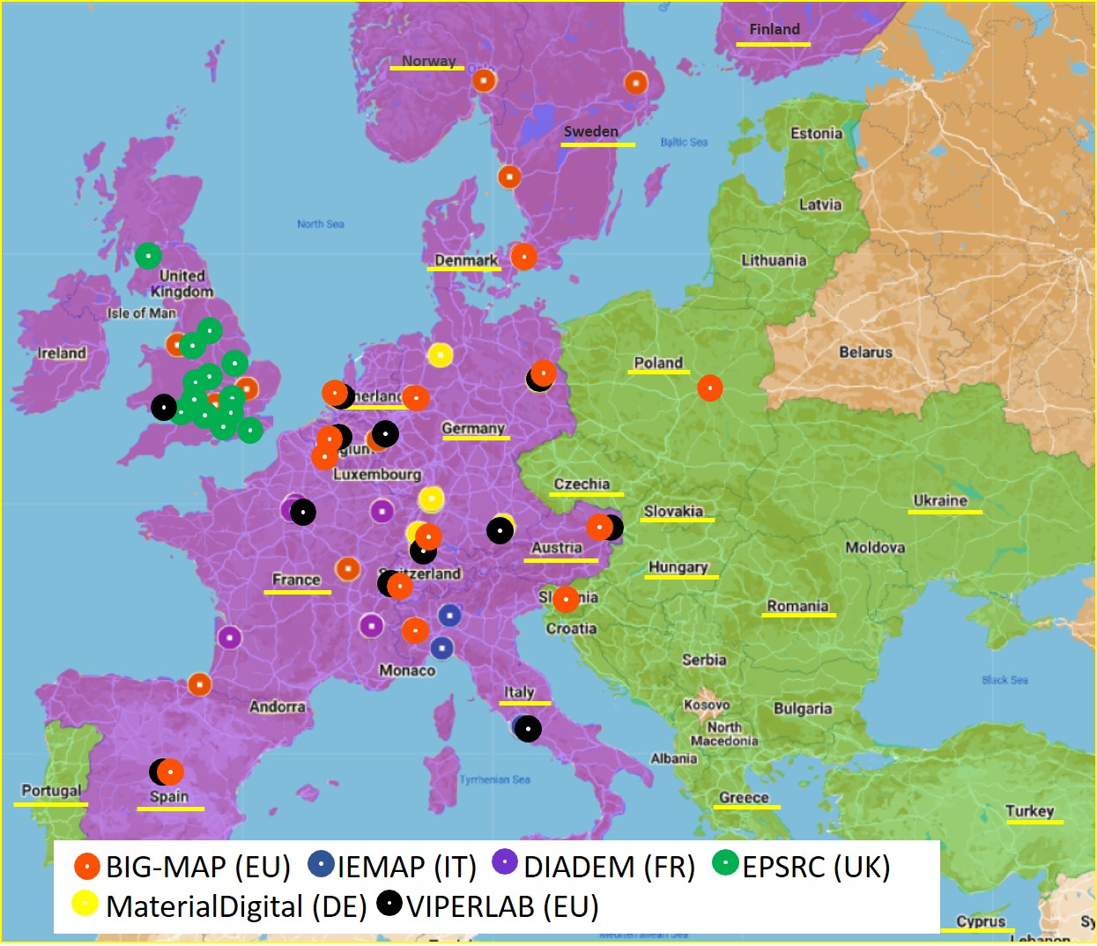
Action Challenges context
State of the art: MAPs​
MAPs are being born all over EU … but….
Many investigators/labs are not participating in MAP
Can benefit from using MAP
Hold valuable data and skills
MAPs are not communicating
Share best practices & bad experiences, complement one another
New advanced tools (ML, robotics..) are required but not enough experts to effectively run and teach, etc., etc.,
Notes:
by identifying common ground and building on areas of overlap
between digital and material competencies (horizontal link): Knowledge sharing and cooperation
between existing SDLs/MAPs, and inclusion of key expertise for maximizing their operation efficiency
and streamlining device integration process.
by identifying common ground and building on areas of overlap
between digital and material competencies (horizontal link): Knowledge sharing and cooperation
between existing SDLs/MAPs, and inclusion of key expertise for maximizing their operation efficiency
and streamlining device integration process.
Upstream integration of advanced materials into functioning devices and scaleup
production taking into account not only the performance (efficiency) requirements, but also the
techno-economic issues, socio-economic impacts and regulatory bodies.

Slide 6
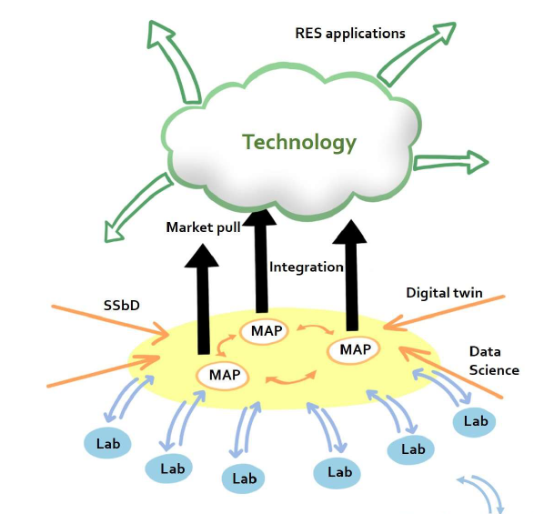
Action Challenges context
EU-MACE​
Inclusiveness (two-way link): Fostering a widespread international community based on gateways to MAPs and accessing relevant
knowledge bases + raw data sharing, characterizations, etc.
Accelerated device integration (horizontal link): Identification of common ground and building on areas of overlap
between digital and material competencies
Market & society pull (upstream flow): Guided integration of advanced materials into functioning devices and scaleup production
Notes:
Inclusive: for the broadest EU research communities
Knowledge base of the participants: data, experimental & numerical techniques; theories, etc.
Accelerated device integration: Knowledge sharing and cooperation
between existing SDLs/MAPs, and inclusion of key expertise for maximizing their operation efficiency
and streamlining device integration process.
Market pull, Societal pull: taking into account not only the performance (efficiency) requirements, but also the
techno-economic issues, socio-economic impacts and regulatory bodies.

Slide 7
Research coordination objectives
Vision: future EU centre of excellence for advanced materials​
Coordinate human resources, knowledge exchange and existing infrastructure among the Action participants to facilitate collaborations and to foster inclusiveness within Europe via a platform sharing agenda with a specific time allocation for scientists from Inclusiveness Target Countries.
Create a collaborative knowledge platform accessible to the public beyond the Action duration.
Provide an example R&D roadmap for accelerated material integration built upon a truly systemic approach.
Coordinate strategic dissemination of activities and results targeting not only research communities, but also companies, policymakers, certification bodies and citizens.

Slide 8
Capacity building objectives
United we succeed​
Interdisciplinary knowledge-sharing space for investigators from all innovation value chains ➔ promote new collaborations to “close the loop” between the R&D and innovation cycle while keeping focus on societal challenges.
Generation and the gender balance ➔ minimize prejudice in the decision making processes when seeking future application and market opportunities.
Prepare ECI and PhD students ➔ lead future ‘systemic approach’ via innovation and entrepreneurship fostering
Continued growth of senior investigators ➔ adapt digital-driven and holistic research approach and speed up the implementation of SDL/MAP-like platforms across Europe.
Trans-national education programmes ➔ academic knowledge spanning all facets of advanced materials development.
Awareness among decision makers ➔ inform potential and challenges of materials research to a wider public.
Notes:
Collaborations from several communities and countries
Opportunities for newly developed advanced materials
Continued growth = (further education) among senior investigators, increase the acceptance-rate of ‘new’ methodologies and collaboration schemes,
Education program for pre-PhD’s prior to settling their PhD research agenda
Decision makers: private and public

Slide 9
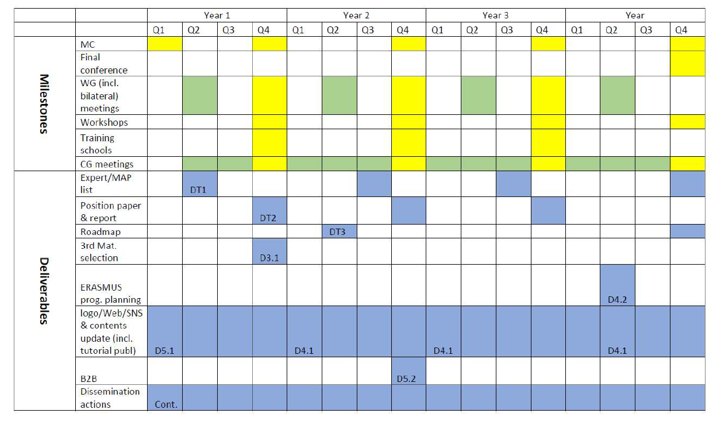
deliverables
As seen on MoU

Slide 10
Meetings/workshops/schools
As seen on MoU
Notes:
Arrows to be presented during the following sessions to advance MC and the workshop. Opportunity arose!

Slide 11
General Action structure
Action Chair
MANAGEMENT COMMITTEE (MC)
GRANT HOLDER (GH)
Vice-Chair
GH scientific rep.
WG1
WG2
WG3
WG4
WG5
WG leaders & WG core group
HORIZONTAL GROUPS
Grant Awarding Coordinator
Science Comm. Coordinator
Transversal Task leaders & Task core group
Nearly ALL Tasks are WG-transversal
WG leaders, Task leaders and Core group members all overlap, interchange and change

Slide 12
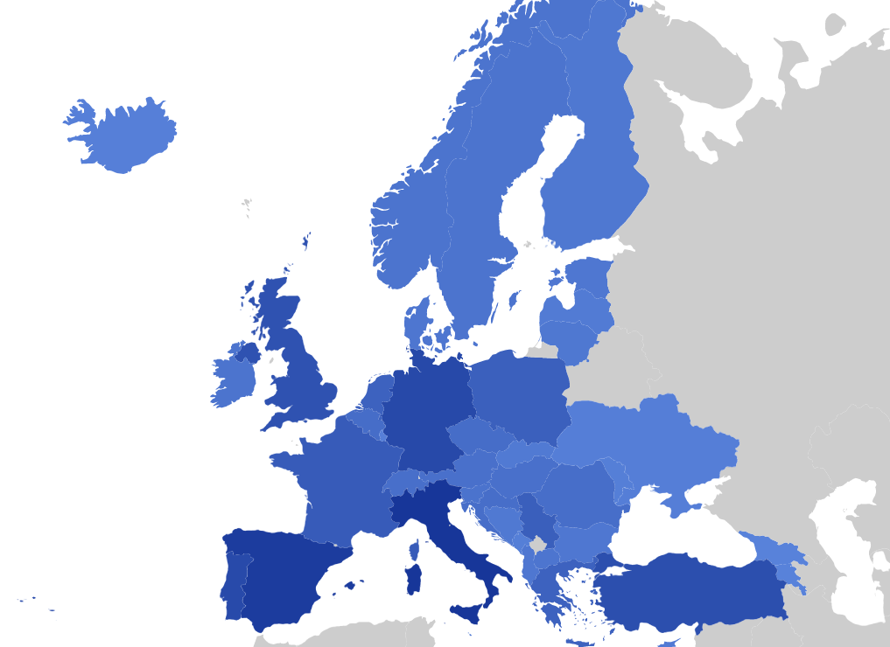
Summary
EU-MACE will build a new systemic research structure for advanced energy materials and integration around Materials Acceleration Platforms through inclusiveness, knowledge exchange and training actions.
Let’s begin!

Slide 13
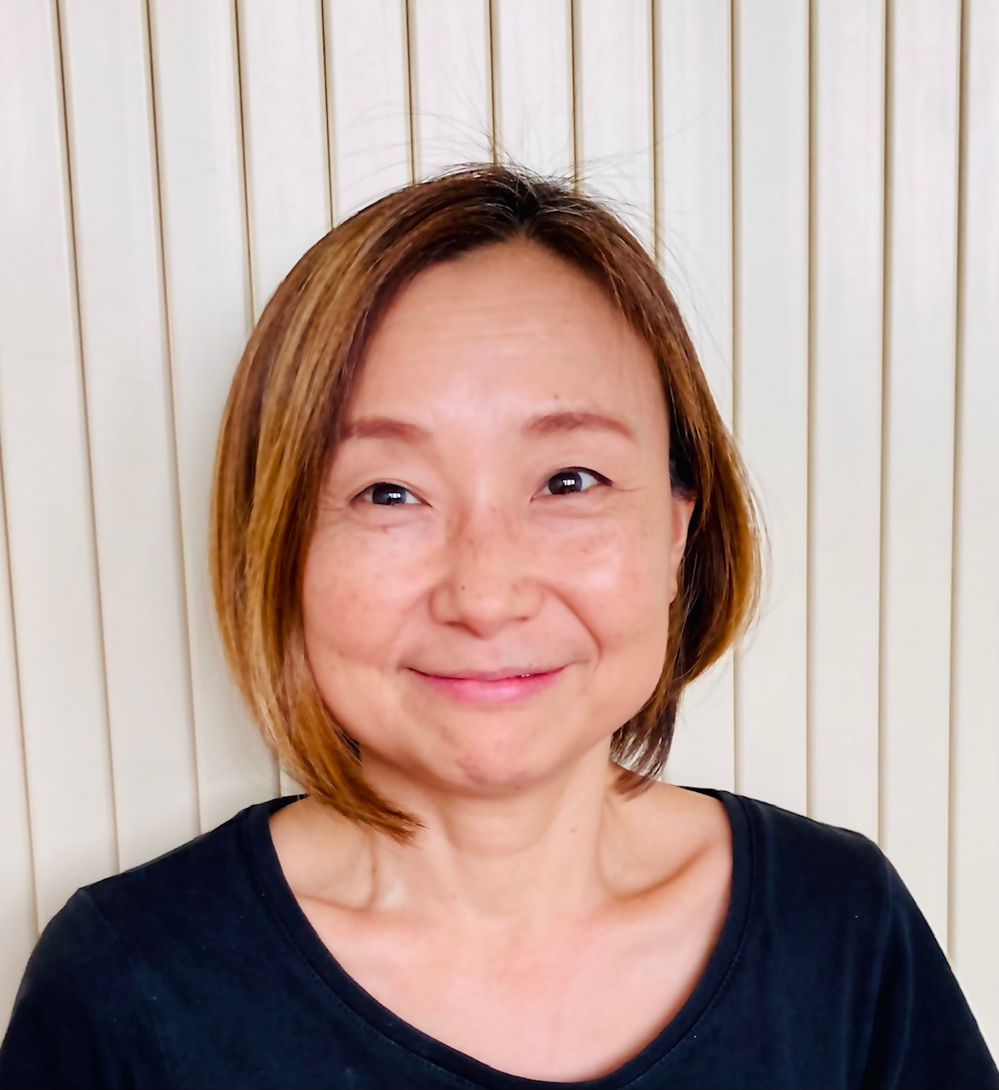
Action chair candidate
Name: Sawako (Saco) Nakamae
Affiliation: Commissariat à l’Energie Atomique et aux Energies Alternatives Saclay, France
Solid State Physics Dept.
Head of Out-of-Equilibrium, Energy and Complexity Lab
Expertise: Experimental Condensed Matter Physics (Magnetism, Irreversible thermodynamics, Thermoelectricity, Complex fluids)
Previous experience with COST: NanoUpTake (MC member) CA15119
Membership & other positions:
EERA/AMPEA (Advanced Material and Processes for Energy Applications)
French Thermoelectricity Research Group (GDR thermoélectricité)
Instructor: Ecole Supérieure d'Ingénieurs Léonard de Vinci (Thermal energy storage)
My motivation: With secondary proposers, built EU-MACE to bring CET solution through Science & Technology (rupture materials). We must all play our part!

Slide 14
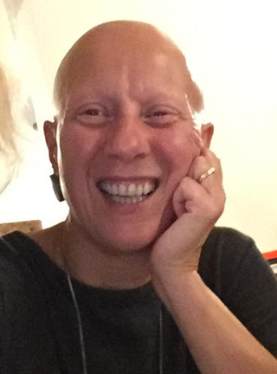
Action VICE-chair candidate
Name/Affiliation: Monica FABRIZIO (CNR, Italy)
She believes that COST Actions, especially EU-MACE, are essential for fostering an environment and culture grounded in cooperation, innovation, openness, independence, and scientific excellence.
Her present activities are categorised into three areas: (a) development and management of projects, (b) research, and (c) teaching and tutoring.
Since 1989, as a researcher and then research manager at CNR, MF has been working on materials for energy applications in a cross-cutting area of physical chemistry and technology. MF has been responsible and coordinator of numerous R&I projects funded by national and regional programs. She has been an evaluator of national, European and international R&D projects. She served as an Italian point of contact for IC#6 "Clean Energy Materials" within the international Mission Innovation initiative (COP21) and is member of EERA Executive Committee.
MF has been involved from the beginning in the design of the EU-MACE Action and its articulation in the different work packages. As Vice-Chair of EU-MACE, she will be able to support the Chair in her tasks, contribute to the decisions of the Steering Committee, and provide its scientific and managerial expertise to the Action in order to implement initiatives and events under the Task on Sustainability.

Slide 15

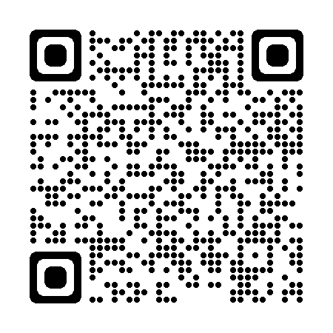
Grant Holder Institution candidate
Commissariat à l’Energie Atomique et aux Energies Alternatives Saclay, France
French government –funded technological research organization (annual budget 5.1 b€)
Maintains a cross-disciplinary culture of engineers and researchers, building on the synergies between fundamental and technological research.
A prominent player in the European research arena involved in setting up collaborative projects with many partner around the world.
CEA-Paris-Saclay & IRAMIS "Saclay Institute of Matter and Radiation" (Fundamental Research Division)
Gathers 6 joint Research Units in association with CNRS, Ecole Polytechnique or ENSICAEN
Mostly fundamental but open to creation of economic value and technology transfer in Nanoscience for communication and health technologies, Radiation-matter interactions and low-carbon energies
> 1000 researchers, engineers, technicians, students & administrative personnel
3 members are involved in scientific actions of EU-MACE
Among active founders of French MAP programme (DIADEM) and other initiatives
DIAMOND (data-science and AI), QUANTIQUE (quantum computing) ….

